Slide 1

Creating Databases and tables

Slide 2
Section Overview
Now that we’ve reached a certain level of comfort on querying and reading data from existing tables and databases, let’s shift our focus to creating our own databases and tables.
Section Overview:
Data Types
Primary and Foreign Keys
Constraints
CREATE
INSERT
UPDATE
DELETE, ALTER, DROP

Slide 3
Section Overview
First we will focus on learning a few theoretical concepts such as choosing the correct data type for a stored value and setting possible constraints on it.
In addition, we will go over Primary and Foreign Keys.

Slide 4
Data types
Below are the main data types that we may have already come across.
Boolean
True or False
Character
char, varchar, and text
Numeric
Integer and floating-point number
Temporal
date, time, timestamp and interval

Slide 5
Data types
When creating databases and tables, we must carefully consider which data types should be used for the data to be stored.
Please use the below documentation for more information on data types:
https://www.postgresql.org/docs/9.5/datatype.html
https://www.postgresql.org/docs/14/datatype-numeric.html

Slide 6
Data types
We must be careful when deciding which data type to choose when storing data.
For example, if we store phone numbers of customers, we may think that we require the integer data type. However, this may lead us to problems.
As there is no arithmetic performed, i.e. performing a mathematical operation on a phone number does not yield anything useful, it is best stores as a text data type.
Another reason why phone numbers should be saved as a string data type is because the zero in front of a phone number may cause issues as, for instance, 07 and 7 are treated the same. However, removing a 0 from the phone number may cause an inconvenience.

Slide 7
Data types
Note: Take your time when creating databases and tables as you should plan for long term storage.
Note: You can always remove historical information that is no longer of use, but you cannot add more information. Therefore it is better to record more information than it is to limit yourself in the long run.

Slide 8
Primary keys and foreign keys
The PRIMARY KEY constraint uniquely identifies each record in a table.
Primary keys must contain UNIQUE values, and cannot contain NULL values.
A table can have only ONE primary key; and in the table, this primary key can consist of single or multiple columns (fields).
Primary keys make it clear as to which columns should be used for joining tables together.
Note: Primary keys are usually an integer data type.
https://www.w3schools.com/sql/sql_primarykey.ASP

Slide 9
Primary keys and foreign keys
The FOREIGN KEY constraint is used to prevent actions that would destroy links between tables.
A FOREIGN KEY is a field (or collection of fields) in one table, that refers to the PRIMARY KEY in another table.
The table with the foreign key is called the child table, and the table with the primary key is called the referenced or parent table.
A table can have multiple foreign keys depending on its relationship with other tables.
https://www.w3schools.com/sql/sql_foreignkey.asp

Slide 10
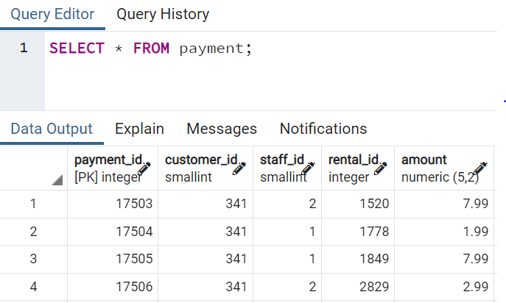
Primary keys and foreign keys
From the table, we observe that the payment_id is the primary key because it says [PK] in the column name.
We also have three other ID’s, they are foreign key references. These keys are the primary keys of another table.
Note: SQL will not inform you of the foreign keys, i.e. it will not say [FK]. It only does that for the Primary Key [PK].

Slide 11
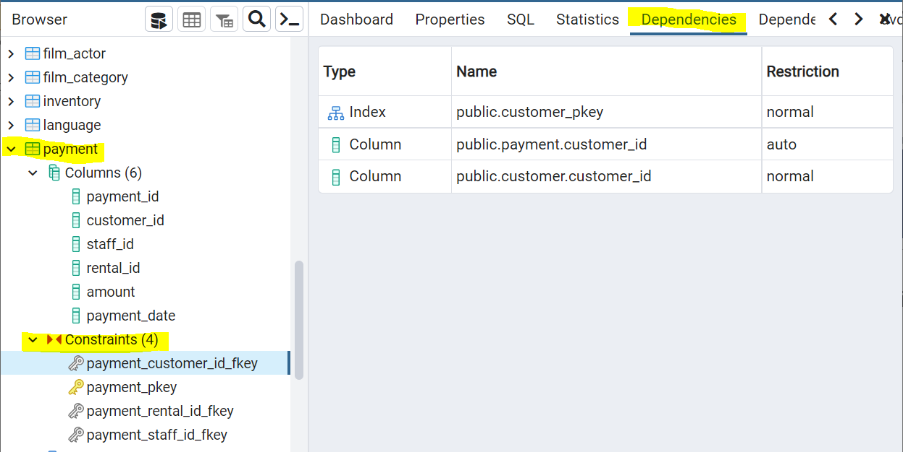
Primary keys and foreign keys
Note: When creating tables and defining columns, we can use constraints to define columns as being a primary key or attaching a foreign key relationship to another table.
To see the dependents of the Foreign Keys, we simply select ‘Dependencies’ at the top, select the table, ‘Constraints’ drop down and select the column.
We can see that the Primary and foreign keys have now been labelled clearly.

Slide 12
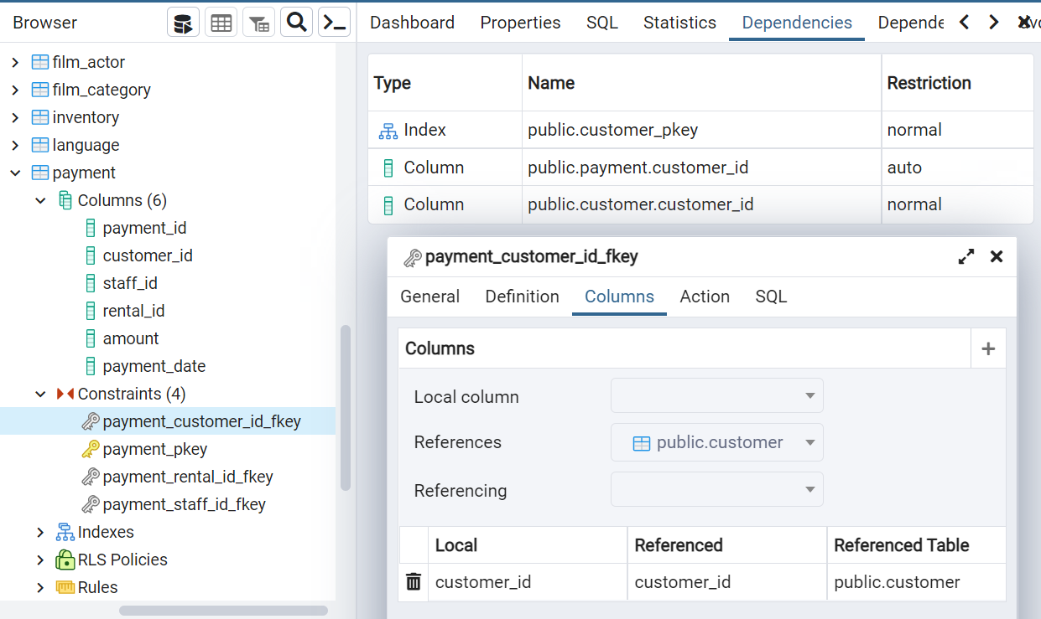
Primary keys and foreign keys
By right clicking the constraint and selecting ‘Properties’ and then ‘Columns’, we see what table the Foreign Key is referring to.

Slide 13
Constraints
Constraints are rules that are enforced on data columns on the table, or the whole table.
Constraints are used to prevent data that is not applicable from entering into the database.
This ensures the data in the database is appropriate, accurate and reliable.

Slide 14
Constraints
We can divide constraints into two main categories, they are:
Column Constraints
Constrains the data in a column to adhere to certain conditions.
Table Constraints
Applied to the entire table rather than to an individual column.

Slide 15
Constraints
Some commonly used constraints:
NOT NULL Constraint
This ensures that no NULL values exist within a column (no empty entries).
UNIQUE Constraint
This ensure that all values within a column are different. For instance, a customer ID column.
PRIMARY Key
Uniquely identifies each row/record in a database table.
FOREIGN Key
Constrains data based on column in other tables.

Slide 16
Constraints
Some commonly used constraints:
CHECK Constraint
This ensures that all values in a column satisfy certain conditions. For instance, all entries must be less than 20.
EXCLUSION Constraint
Ensures that if any two rows are compared on a specified column or expression using the specified operator, not all of these comparisons will return TRUE.

Slide 17
Constraints
Table Constraints:
CHECK Condition
To check a condition when inserting or updating data.
References
To constrain the value stored in the column that must exist in a column of another table.

Slide 18
Constraints
Table Constraints:
UNIQUE (Column list)
Forces the values stored in the columns listed inside the parentheses to be unique.
PRIMARY KEY (Column list)
Allows you to define the primary key that consists of multiple columns.

Slide 19
CREATE
We will now learn the syntax to create a table in SQL using the CREATE keyword and column syntax.
General syntax for CREATE:
CREATE TABLE table_name(
column_name TYPE column_constraint,
column_name TYPE column_constraint,
table_constraint table_constraint)
INHERITS existing_table_name;

Slide 20
CREATE
General simple syntax for CREATE:
CREATE TABLE table_name(
column_name TYPE column_constraint,
column_name TYPE column_constraint);
Example syntax:
CREATE TABLE customers(
customer_id SERIAL PRIMARY KEY,
age SMALLINT NOT NULL);

Slide 21
CREATE
SERIAL data type allows you to automatically generate unique integer numbers (IDs, identity, auto-increment, sequence) for a column.
These numbers will be a sequence of integers.
A sequence is often used as a primary key column in a table.
Therefore, this is perfect for a primary key, because it logs unique integer entries for us automatically upon insertion.
If a row is later removed, the column with the SERIAL date type will not adjust. This makes it evident that a row was removed from the sequence. For instance, in the sequence 1,2,4,5, we know at some point row 3 was removed.
https://www.postgresql.org/docs/14/datatype-numeric.html

Slide 22
CREATE
Let’s now practice this using SQL.
Right click any existing query editors and click remove panel. We are not required to save so select do not save.
To create a new database we:
Right click databases / Create / Database…
Name the database Learning (or whatever you choose) / Click Save
Right Click Learning / Select Query Tool (query tool is not only used for getting information from a database, but we can also run SQL commands to create tables from here).

Slide 23
CREATE
Exercise: Create a table named account with six columns: user_id, username, password, email, created_on and last_login. Remember to appropriately set the TYPE and column constraint.
Query:
CREATE TABLE account(
user_id SERIAL PRIMARY KEY,
username VARCHAR(50) UNIQUE NOT NULL,
password VARCHAR(50) NOT NULL,
email VARCHAR(250) UNIQUE NOT NULL,
created_on TIMESTAMP NOT NULL,
last_login TIMESTAMP);

Slide 24
CREATE
Exercise: Create a table named job with two columns: job_id and job_name. Remember to appropriately set the TYPE and column constraint.
Query:
CREATE TABLE job(
job_id SERIAL PRIMARY KEY,
job_name VARCHAR(200) UNIQUE NOT NULL);

Slide 25
CREATE
Exercise: Create a table named account_job with three columns: user_id, job_id and hire_date. Remember to appropriately set the TYPE and column constraint. The user_id and job_id columns are the original columns from the account and job tables respectively.
Query:
CREATE TABLE account_job(
user_id INTEGER REFERENCES account(user_id),
job_id INTEGER REFERENCES job(job_id),
hire_date TIMESTAMP);
Note: Were not using SERIAL as SERIAL should only be used as a primary key for the table that it's in when using it to reference in another table. This will show up as a normal integer because SERIAL is a sequence of integers.

Slide 26
Insert
The INSERT INTO statement is used to insert new records in a table.
Syntax for INSERT INTO:
INSERT INTO table (Column_1, Column_2, …)
VALUES (Value_1, Value_2, …),
(Value_1, Value_2, …), … ;

Slide 27
Insert
The INSERT INTO statement can also be used to insert records from an already existing table.
Syntax for INSERT INTO from another table:
INSERT INTO table(Column_1, Column_2, …)
SELECT Column_1, Column_2, …
FROM another_table
WHERE condition;
Note: Inserted row values must match up for the table, including constraints.
Note: Serial columns do not need to be provided a value. As serial is a sequence, it will automatically update the subsequent rows.

Slide 28
Insert
Exercise: Insert a row into the account table we just created. In the account table, insert a customer row with username = Jose, password = password, email = jose@mail.com with the created on column being set to the current date and time (i.e. right now).
Query:
INSERT INTO account (username, password, email, created_on)
VALUES ('Jose','password', 'jose@mail.com', CURRENT_TIMESTAMP);

Slide 29
Insert
Exercise: Insert a row into the job table we just created. In the job table, insert a customer row with job_name = Astronaut.
Query:
INSERT INTO job(job_name)
VALUES ('Astronaut');

Slide 30
Insert
Exercise: Insert a row into the account_job table we just created. In the account_job table, insert a customer row where user_id = 1, job_id = 1 and hire_date = current date and time.
Query:
INSERT INTO account_job(user_id, job_id, hire_date)
VALUES (1, 1, CURRENT_TIMESTAMP);

Slide 31
Update
The UPDATE statement is used to modify the existing records in a table.
Syntax for UPDATE:
UPDATE Table_Name
SET Column_1 = Value_1, Column_2 = Value_2,
WHERE condition;

Slide 32
Update
Exercise: UPDATE the account table. The last_login column was empty, update the table so it is populated by the CURRENT_TIMESTAMP.
Query:
UPDATE account
SET last_login = CURRENT_TIMESTAMP
WHERE last_login IS null;
Note: If we do not have the WHERE conditions, the whole table will simply update.
Note: We can set the WHERE condition to another column. Therefore two columns simply mirroring each other.

Slide 33
Update
We can also use another tables values (UPDATE JOIN).
Syntax for UPDATE JOIN:
UPDATE Table_A
SET Original_Column_Of_Table_A = TableB.New_Column
FROM TableB
WHERE TableA.id = TableB.id;

Slide 34
Update
When updating a table, we notice that we must manually select the table name after running the UPDATE query to see the updated records within the table. However, with RETURNING, we can update and view the new updated records in one go.
Syntax for RETURNING:
UPDATE Table_Name
SET Column_1 = Values_1
RETURNING Column_1, Column_2, Column_3;

Slide 35
Update
Exercise: UPDATE the accounts table by setting the created_on column to the values in the last_login column. Also, so we don’t need to run another query, return the created_on and last_login columns to check that they match.
Query:
UPDATE account
SET last_login = created_on
RETURNING created_on, last_login;

Slide 36
Update
Exercise: UPDATE the account_job table by setting the hire_date column to the created_on column from the account table. Also, so we don’t need to run another query, return the created_on and last_login columns to check that they match.
Query:
UPDATE account_job
SET hire_date = account.created_on
FROM account
WHERE account_job.user_id = account.user_id
RETURNING account_job.hire_date, account.created_on, last_login;

Slide 37
delete
DELETE is used for removing rows from a table.
Syntax for DELETE:
DELETE FROM Table_Name
WHERE row_id = 1;
DELETE can be used to remove rows on their presence in other tables.
Example:
DELETE FROM TableA
USING TableB
WHERE TableA.id = TableB.id

Slide 38
delete
We can DELETE all the rows from a table by using the DELETE clause by not specifying any conditions.
Syntax for removing all rows at once:
DELETE FROM Table_Name
Note: Similar to the UPDATE command, we can add the RETURNING clause to return the rows that were removed.

Slide 39
delete
Exercise: Add a job name to the job table.
Query:
INSERT INTO job(job_name)
VALUES ('NewJob’)
RETURNING job;

Slide 40
delete
Exercise: Remove the new job name from the job table. Return the rows to ensure the desired row was removed.
Query:
DELETE FROM job
WHERE job_name = 'NewJob’
RETURNING job_id, job_name;

Slide 41
ALTER
ALTER allows us to make changes to an existing table structure.
The ALTER TABLE statement is used to add, delete, or modify columns in an existing table.
We may also change a columns data type, set DEFAULT values for a column and rename the table.
The ALTER TABLE statement is also used to add and drop various constraints on an existing table.

Slide 42
ALTER
Syntax for ALTER TABLE:
ALTER TABLE table_name action;
Syntax for adding columns:
ALTER TABLE table_name
ADD COLUMN new_column_name TYPE;

Slide 43
ALTER
Syntax for altering constraints:
ALTER TABLE table_name
ALTER COLUMN column_name
SET NOT NULL;
ALTER TABLE table_name
ALTER COLUMN column_name
ADD CONSTRAINT constraint_name;

Slide 44
ALTER
Exercise: Create a table called information with three columns; info_id which is the primary key, title which cannot be empty and people that cannot be empty and must be unique.
CREATE TABLE information(
info_id SERIAL PRIMARY KEY,
title VARCHAR(500) NOT NULL,
person VARCHAR(50) NOT NULL UNIQUE);

Slide 45
ALTER
Exercise: Rename the ‘information’ table to ‘new_info’.
Query:
ALTER TABLE information
RENAME TO new_info;
Exercise: Rename the ‘person’ column to ‘people.
Query:
ALTER TABLE new_info
RENAME COLUMN person to people;

Slide 46
ALTER
Exercise: Insert a new title called ‘New Job’ into the new_info table.
Query:
INSERT INTO new_info(title)
VALUES (‘New Job’);
Looks like we need to remove a constraint …

Slide 47
ALTER
Exercise: Remove the ‘DROP NOT NULL’ constraint from the ‘people’ column.
Query:
ALTER TABLE new_info
ALTER COLUMN people DROP NOT NULL;
Exercise: Insert a new title called ‘New Job’ into the new_info table.
Query:
INSERT INTO new_info(title)
VALUES (‘New Job’);

Slide 48
ALTER
For the full documentation, consult the below link …
https://www.postgresql.org/docs/14/sql-altertable.html

Slide 49
Drop
The DROP COLUMN command is used to delete a column in an existing table.
This will automatically remove the columns indexes and constraints.
However, it will not remove columns used in views, triggers, or stored procedures without the additional CASCADE clause.
CASCADE: When the child data is either deleted or updated when the parent data is deleted or updated.

Slide 50
Drop
Syntax for DROP:
ALTER TABLE table_name
DROP COLUMN column_name;
Syntax for removing all dependencies:
ALTER TABLE table_name
DROP COLUMN column_name CASCADE;

Slide 51
Drop
Syntax for checking if the column exists to avoid error:
ALTER TABLE table_name
DROP COLUMN IF EXISTS column_name;
Syntax for dropping multiple columns:
ALTER TABLE table_name
DROP COLUMN column_name_1,
DROP COLUMN column_name_2;

Slide 52
Drop
Exercise: Drop the ‘people’ column from the new_info table. Use IF EXISTS in case of any errors.
Query:
ALTER TABLE new_info
DROP COLUMN IF EXISTS people;

Slide 53
check
The CHECK constraint is used to limit the value range that can be placed in a column.
If you define a CHECK constraint on a column it will allow only certain values for this column.
If you define a CHECK constraint on a table it can limit the values in certain columns based on values in other columns in the row.

Slide 54
check
Syntax for CHECK:
CREATE TABLE table_name(
column_id SERIAL PRIMARY KEY,
age SMALLINT CHECK (age>21),
parent_age SMALLINT CHECK (parent_age > age));

Slide 55
check
Exercise: Create a table called employess with the following columns: emp_id, first_name, last_name, birthdate, hire_date and salary.
Note: The following must have the constraints: birthdate grater than 1900-01-01, hire_date greater than birthdate and salary greater than zero.

Slide 56
check
Query:
CREATE TABLE employees(
emp_id SERIAL PRIMARY KEY,
first_name VARCHAR(50) NOT NULL,
last_name VARCHAR(50) NOT NULL,
birthdate DATE CHECK (birthdate > '1900-01-01’),
hire_date DATE CHECK (hire_date > birthdate),
salary INTEGER CHECK (salary > 0));

Slide 57
check
Exercise: Insert into the employees table a person called Abbie Brunwick, who was born on 1990-11-03, was hired 2010-01-01 with a salary of 100.
INSERT INTO employees(first_name, last_name, birthdate, hire_date, salary)
VALUES ('Abbie', 'Brunwick', '1990-11-03', '2010-01-01', 100);

Slide 58
check
Exercise: Insert into the employees table a person called Charlie Darnell, who was born on 1990-11-03, was hired 2010-01-01 with a salary of 100.
INSERT INTO employees(first_name, last_name, birthdate, hire_date, salary)
VALUES ('Charlie', 'Darnell', '1990-11-03', '2010-01-01', 100);

Slide 59
Exercises
Create a new database called ‘school’. The database should contain two tables called ‘teachers’ and ‘students’. The students table should contain the columns: student_id, first_name, last_name, homeroom_number, phone, email and graduation year. The teachers table should contain the columns: teacher_id, first_name, last_name, homeroom_number, department, email and phone.
Note: Your table constraint must consider the following:
We must have an emergency contact number for each student in case of an emergency.
We must have id’s as the primary key of the tables.
Phone numbers and emails must be unique to the individual.

Slide 60


End of Section.
Well done you hit this section out the ball park!

